Slide 1

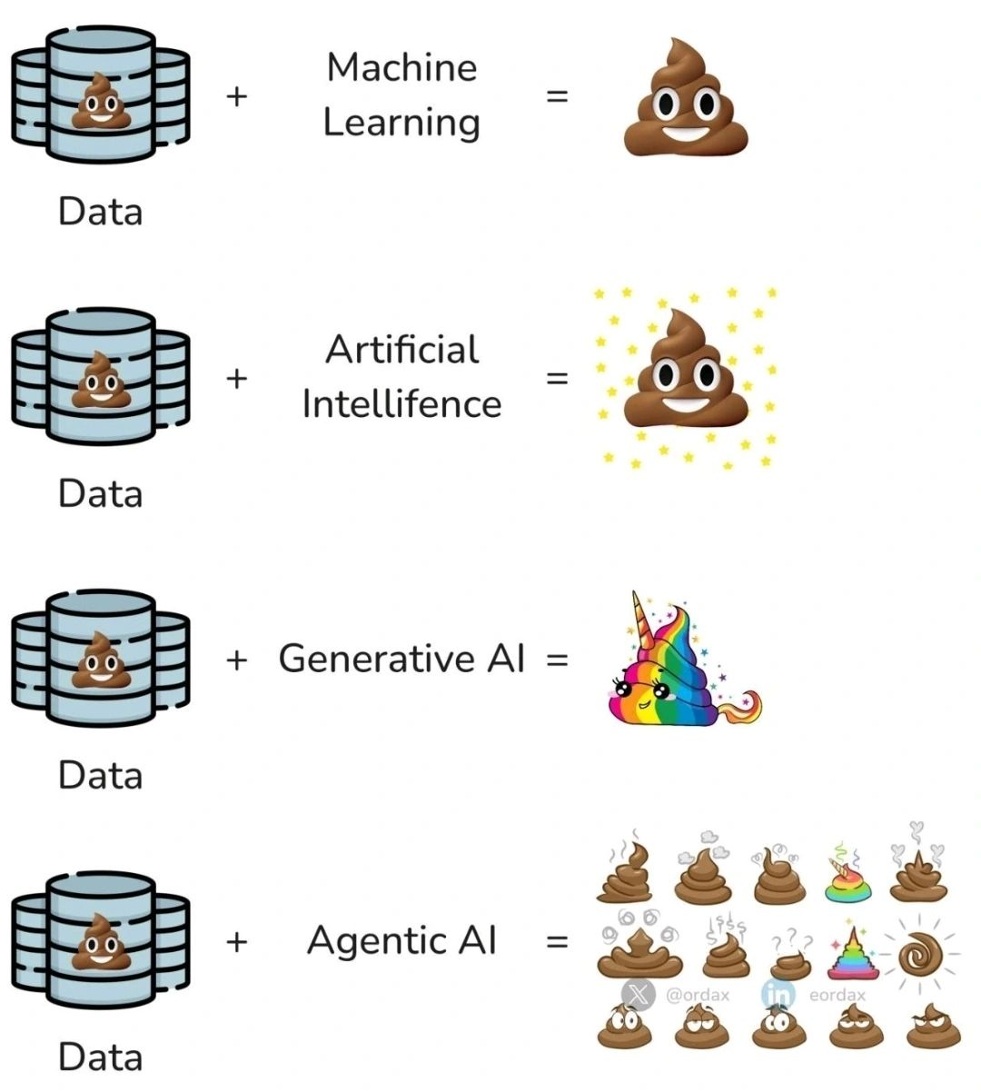
Machine Learning is not a Magician
Posted by Victor Martins on LinkedIn

Slide 2
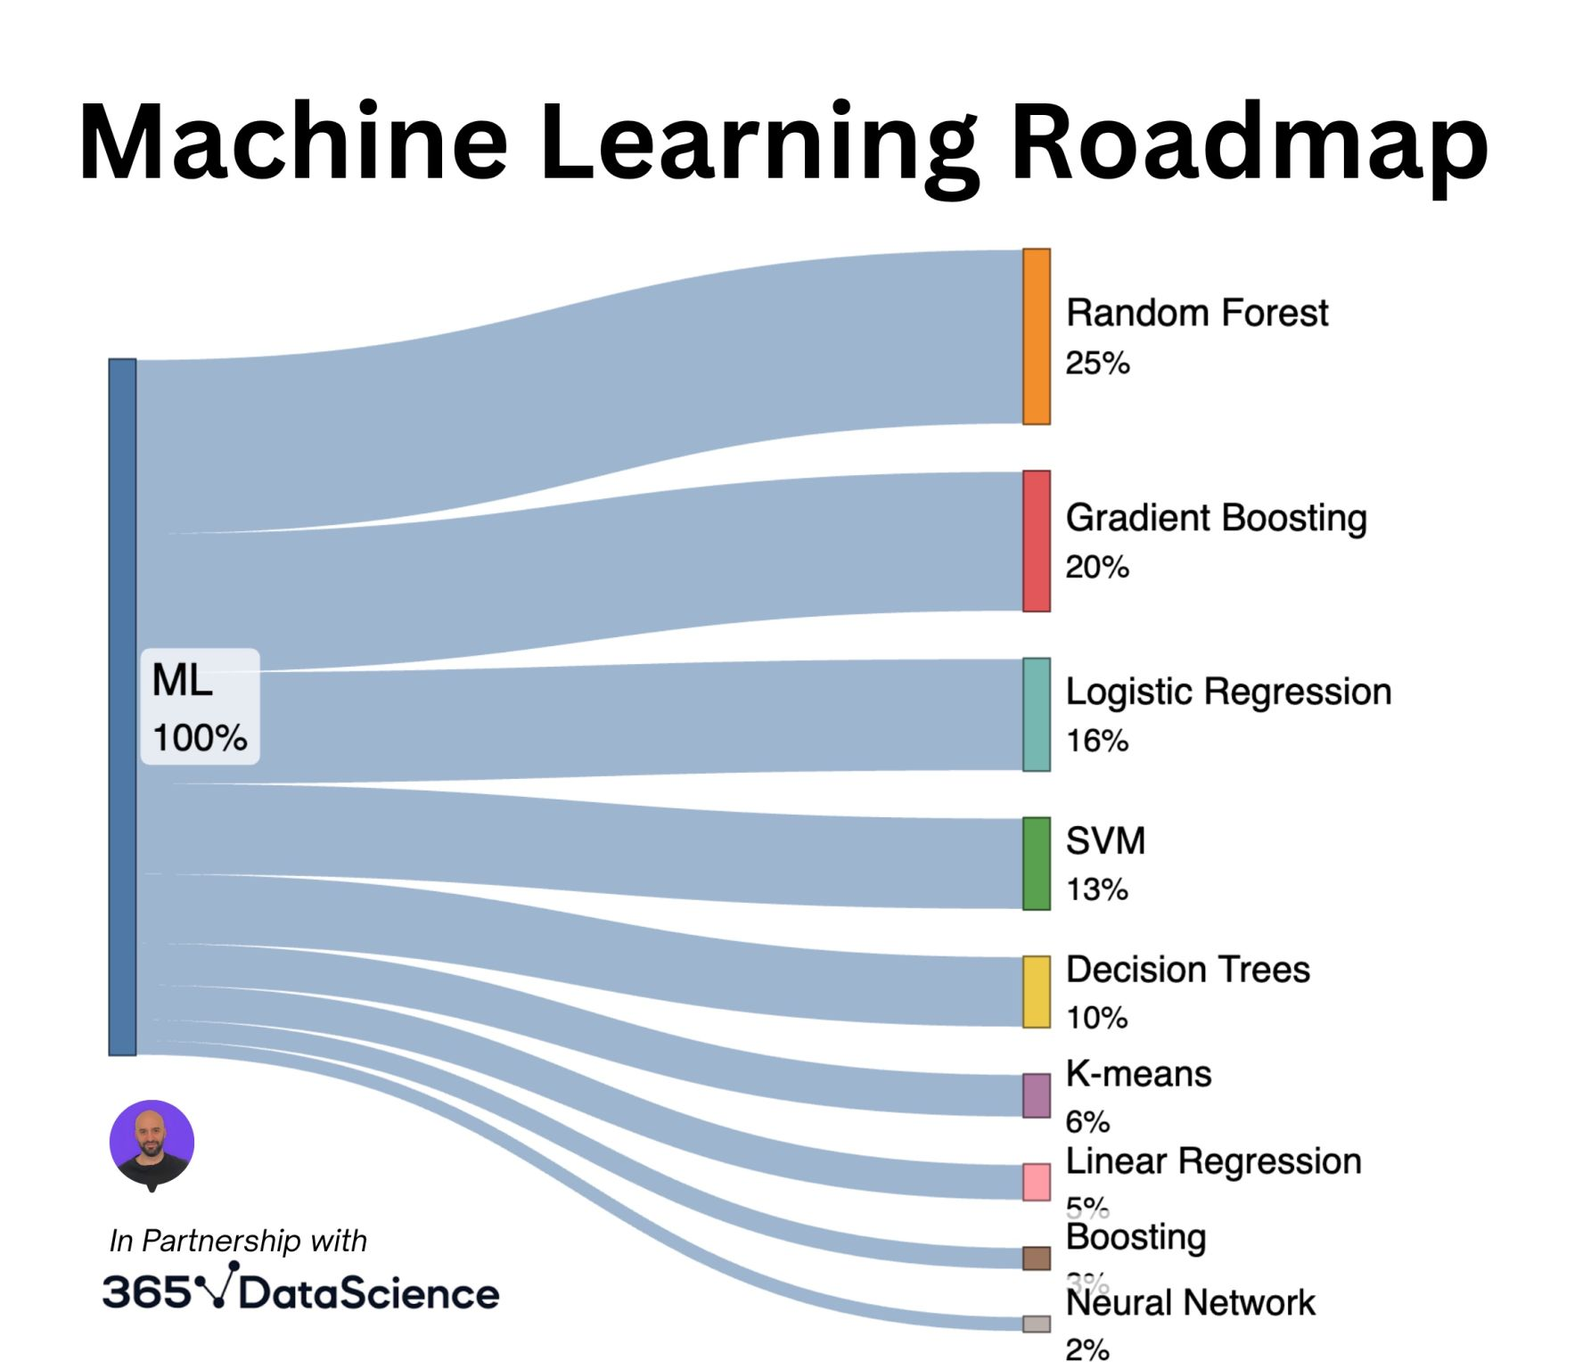
Models Applied in Machine Learning
Posted by Amney Mounir on LinkedIn

Slide 3
Supervised Machine Learning
ID | IV1 | IV2 | IV3 | DV
1 | A | B | C | D | ML coefficient + Binary: Accuracy between DV and Predicted DV Numeric: R-squared (R2) + ML model file
2 | AA | BB | CC | DD
3 | AAA | BBB | CCC | DDD
Training/validation Data
ID | IV1 | IV2 | IV3 | DV | Predicted DV value
4 | A | BB | C | D/?
5 | AA | BB | CC | DDD/?
6 | AAA | BBB | CCC | DD/?
Prediction Data

Slide 4
Supervised Machine Learning Independent Variable Backward Selection Based on Model Coefficient
Independent variable list | Model coefficient
IV1 | 3
IV2 | 0.001
IV3 | -3
*IV2 excluded due to low coefficient

Slide 5
Converting multi-level Variable(s) into Binary Value
Original data |  |  |  |  | Multi-level variable(s) binary-conversion
ID | Age | Blood Pressure | Body Weight |  | ID | AGE 35-64 years | AGE Over 65 years | AGE Younger than 35 years | Blood Pressure | Body Weight
1 | Over 65 years | 150 | 115 |  | 1 | 0 | 1 | 0 | 150 | 115
2 | 35 - 64 years | 149 | 108 |  | 2 | 1 | 0 | 0 | 149 | 108
3 | Younger than 35 years | 93 | 102 |  | 3 | 0 | 0 | 1 | 93 | 102
4 | Younger than 35 years | 96 | 104 |  | 4 | 0 | 0 | 1 | 96 | 104
5 | 35 - 64 years | 106 | 113 |  | 5 | 1 | 0 | 0 | 106 | 113
6 | Younger than 35 years | 96 | 108 |  | 6 | 0 | 0 | 1 | 96 | 108
7 | 35 - 64 years | 142 | 108 |  | 7 | 1 | 0 | 0 | 142 | 108
8 | Over 65 years | 141 | 115 |  | 8 | 0 | 1 | 0 | 141 | 115
9 | 35 - 64 years | 105 | 107 |  | 9 | 1 | 0 | 0 | 105 | 107
10 | 35 - 64 years | 105 | 103 |  | 10 | 1 | 0 | 0 | 105 | 103
11 | 35 - 64 years | 110 | 106 |  | 11 | 1 | 0 | 0 | 110 | 106
12 | Younger than 35 years | 93 | 111 |  | 12 | 0 | 0 | 1 | 93 | 111
13 | 35 - 64 years | 102 | 102 |  | 13 | 1 | 0 | 0 | 102 | 102
14 | 35 - 64 years | 101 | 105 |  | 14 | 1 | 0 | 0 | 101 | 105
15 | Younger than 35 years | 96 | 108 |  | 15 | 0 | 0 | 1 | 96 | 108
16 | 35 - 64 years | 143 | 111 |  | 16 | 1 | 0 | 0 | 143 | 111
17 | 35 - 64 years | 109 | 101 |  | 17 | 1 | 0 | 0 | 109 | 101
18 | Younger than 35 years | 94 | 105 |  | 18 | 0 | 0 | 1 | 94 | 105
19 | 35 - 64 years | 104 | 110 |  | 19 | 1 | 0 | 0 | 104 | 110
20 | 35 - 64 years | 102 | 114 |  | 20 | 1 | 0 | 0 | 102 | 114

Slide 6
Descriptive Analysis Result of the Simulated Data
Variable | Statistic or Category | All | Without diabete diagnosis | With diabete diagnosis | P value
 |  | (N = 2,000) | (N = 1,329) | (N = 671)
Age, N (%) | 35 - 64 years | 603 (30.2%) | 393 (29.4%) | 210 (31.6%) | <0.001^{C}
 | Over 65 years | 583 (29.2%) | 222 (16.6%) | 361 (54.3%)
 | Younger than 35 years | 814 (40.7%) | 720 (53.9%) | 94 (14.1%)
AGE 35 - 64 years, N (%) | 0 | 1,397 (69.9%) | 942 (70.6%) | 455 (68.4%) | 0.326^{C}
 | 1 | 603 (30.2%) | 393 (29.4%) | 210 (31.6%)
AGE Over 65 years, N (%) | 0 | 1,417 (70.9%) | 1,113 (83.4%) | 304 (45.7%) | <0.001^{C}
 | 1 | 583 (29.2%) | 222 (16.6%) | 361 (54.3%)
AGE Younger than 35 years, N (%) | 0 | 1,186 (59.3%) | 615 (46.1%) | 571 (85.9%) | <0.001^{C}
 | 1 | 814 (40.7%) | 720 (53.9%) | 94 (14.1%)
Body Weight | Mean (SD) | 107.95 (4.38) | 107.87 (4.40) | 108.11 (4.34) | 0.233^{W}
 | Median (Q1 to Q3) | 108.0 (104.0 to 112.0) | 108.0 (104.0 to 112.0) | 108.0 (104.0 to 112.0)
 | Range | 101.0 to 115.0 | 101.0 to 115.0 | 101.0 to 115.0
Blood Pressure | Mean (SD) | 116.92 (22.16) | 108.23 (18.49) | 134.37 (18.32) | <0.001^{W}
 | Median (Q1 to Q3) | 108.0 (97.0 to 144.0) | 100.0 (95.0 to 111.0) | 144.0 (117.0 to 147.0)
 | Range | 91.0 to 150.0 | 91.0 to 150.0 | 91.0 to 150.0

Slide 7
SAS PROC LOGISTICS vs Supervised ML LogisticRegression
(on binary dependent variable/label)
 |  | SAS PROC LOGISTIC with 0 as reference for all AGE covariates |  |  |  | Python Supervised
Independent Variables (Labels) |  | Level | OR (95%CI) | Prediction accuracy |  | Model Coefficient | Prediction accuracy
AGE 35 - 64 years |  | 1 | 1.84 (1.30 to 2.61) | 0.7675 |  | 0.069769012 | 0.7925
AGE Over 65 years |  | 1 | 2.96 (2.05 to 4.29) |  |  | 0.54472131
AGE Younger than 35 years |  | 1 | Missing due to liner combination of the above |  |  | -0.614482111
Body Weight |  |  | 1.05 (1.04 to 1.06) |  |  | 0.049350464
Blood Pressure |  |  | 1.01 (0.978 to 1.04) |  |  | 0.016836353
*Another popular applied ML model, RandomForestClassifier, can only provide 0.075 on prediction accuracy.

Slide 8
SAS PROC REG vs Supervised ML LinearRegression
(on numeric dependent variable/label)
 |  | SAS PROC REG |  |  | Python Supervised ML
Independent Variables (Labels) |  | Parameter estimate | R-squared (R2) |  | Model Coefficient | R-squared (R2)
AGE 35 - 64 years |  | 15.98 ± 0.93 | 0.5373 |  | 1.460406899 | 0.5595
AGE Over 65 years |  | 28.02 ± 1.02 |  |  | 13.21703529
AGE Younger than 35 years |  | Missing due to liner combination of the above |  |  | -14.67742157
Body Weight |  | 0.04 ± 0.09 |  |  | -0.141240969
Blood Pressure |  | 15.01 ± 0.89 |  |  | 15.04423428
*Another popular applied ML model, RandomForestRegressor, provides 0.4933 on R-squared (R2).

Slide 9
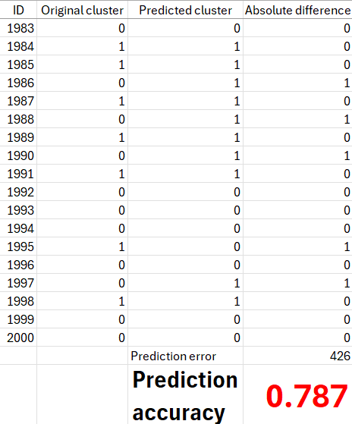
Prediction Accuracy of Un-supervised ML

Slide 10
Natural Language Processing Prefers Cleaned & Simplified Text
Original text | Cleaned/simplified text for NLP
I love this product's | i love product'
Worst thing ever | worst thing ever
Amazing experience | amaz experi
Terrible waste of money | terribl wast money

